Slide 1
Autonomous Smart Parking System (ASPS)
IBM Naan Mudhalvan-Group 2
Internet Of Things(IOT)
5113: Kingston Engineering College
By:
Naveen Moses D | au511321106017 | naveenmosesdinesh@gmail.com
Karthick V | au511321106014 | karthicksparrow201@gmail.com
T.N.Uthrakumar | autle-02ece | uthrakumar608@gmail.com
Sanjay Kumar S | au511321106020 | sanjaysivakumar0910@gmail.com

Slide 2
TABLE OF CONTENTS
PHASE 1
01
02
03
Problem Definition and Design Thinking
PHASE 2
Innovation
PHASE 3
Development Part 1
04
PHASE 4
Development Part 2

Slide 3
PHASE 1

Slide 4
Autonomous Smart Parking System (ASPS)
IBM Naan Mudhalvan-Group 2
Internet Of Things(IOT)
5113: Kingston Engineering College
By:
Naveen Moses D | au511321106017 | naveenmosesdinesh@gmail.com
Karthick V | au511321106014 | karthicksparrow201@gmail.com
T.N.Uthrakumar | autle-02ece | uthrakumar608@gmail.com
Sanjay Kumar S | au511321106020 | sanjaysivakumar0910@gmail.com

Slide 5
CONTENTS
Project Definition
Design Thinking
Project Objectives
IoT Sensor Design
Real-Time Transit Information Platform
Integration Approach

Slide 6
TABLE OF CONTENTS
01
Project Definition
02
Design Thinking
Project Objectives
IoT Sensor Design
Real-Time Transit Information Platform
Integration Approach
The Autonomous Smart Parking System (ASPS) revolutionizes urban transportation by integrating IoT technologies (GPS, RADAR, ground sensors) via ESP32 devices, enabling efficient, automated parking without human intervention.

Slide 7
01
Project Definition
Project Abstract

Slide 8
Project Definition
The Autonomous Smart Parking System (ASPS) presented in this project represents a groundbreaking advancement in urban transportation management by seamlessly integrating IoT technologies such as GPS, RADAR, and ground sensors through ESP32 devices. This innovative system eliminates the need for human intervention, making parking more efficient, convenient, and environmentally friendly.
The ASPS leverages real-time data from a combination of GPS, RADAR, and ground sensors to accurately detect and manage available parking spaces in urban areas. The ESP32 microcontrollers serve as the central nodes for data processing and communication within the system, ensuring smooth coordination and responsiveness.

Slide 9
02
Design Thinking
Human-Centered Design.

Slide 10
Design Thinking
The IoT-based Smart Parking System aims to revolutionize urban transportation by autonomously parking vehicles without human intervention. Utilizing GPS, RADAR, and ground sensors connected via ESP32 microcontrollers, this system efficiently detects available parking spots and guides vehicles to them. Users can easily reserve parking spots through a mobile app, receive real-time updates on their vehicle's location, and enjoy a hassle-free parking experience. The project focuses on reducing traffic congestion, enhancing user convenience, optimizing parking space utilization, and minimizing environmental impact.

Slide 11




Design Thinking
Project Objectives
Real-Time Transit Information Platform:
Integration Approach
IoT Sensor Design

Slide 12
Project Objectives
Objective: Create an autonomous parking system to enhance urban transportation efficiency.
Technologies: Utilize GPS for vehicle location tracking, RADAR sensors for obstacle detection, ground sensors for spot detection, and ESP32 microcontrollers for data processing and communication.
User Interface: Develop a mobile application for user interaction, including parking requests, spot tracking, and notifications.
Workflow: Vehicles will be guided to available parking spots through ESP32-controlled actuators after spot detection using integrated sensors.

Slide 13
Project Objectives
Benefits: Reduce traffic congestion, fuel consumption, and environmental impact while improving user convenience.
Data Integration: Implement a real-time data fusion algorithm to combine information from GPS, RADAR, and ground sensors for accurate spot detection.
Hardware and Software: Procure necessary hardware components and develop firmware for ESP32 devices, mobile app, and cloud-based server for data storage and analysis.
Testing and Optimization: Rigorous testing and user feedback will be used to optimize system performance.

Slide 14
IoT Sensor Design
GPS Sensor: Provides accurate vehicle location data for real-time tracking and navigation within the parking area.
RADAR Sensors: Used for obstacle detection, especially for detecting moving vehicles or pedestrians in the parking area.
Ultrasonic Sensors: Can complement RADAR sensors by detecting stationary objects, ensuring comprehensive obstacle detection.
Infrared Sensors: Useful for detecting the presence of vehicles in parking spots and at entry/exit points.
Ground Sensors (Inductive Loop or Capacitive): Detect the occupancy of individual parking spots by sensing the presence of a vehicle's metal mass.

Slide 15
IoT Sensor Design
Optical Sensors: Can be used for spot detection by measuring changes in light or infrared radiation when a vehicle enters or leaves a parking space.
Lidar Sensors: Offer high-precision mapping and object detection capabilities, enhancing obstacle detection and mapping.
Proximity Sensors: Detect the proximity of objects or vehicles in designated areas, helping in collision avoidance.
Image Sensors (Cameras): Capture images or video feed for advanced visual recognition, supporting both spot detection and security.

Slide 16
Real-Time Transit Information Platform
Multi-Sensor Integration: Create a comprehensive data fusion system that combines data from GPS, RADAR, and ground sensors through ESP32 microcontrollers. This integrated sensor network accurately detects available parking spaces and manages vehicle movements in real-time.
User-Friendly Mobile App: Develop a user-friendly mobile application that allows users to interact with the Smart Parking System. Users can request parking, track their vehicle's location, and receive real-time updates on the parking process, ensuring a seamless and convenient experience.

Slide 17
Real-Time Transit Information Platform
Autonomous Vehicle Control: Implement an automated vehicle control system using ESP32-controlled actuators. When a user requests parking, the system guides the vehicle to an available spot without human intervention, optimizing parking efficiency.
Real-Time Transit Information: Integrate a transit information platform that provides real-time updates on parking availability, traffic conditions, and estimated travel times. This platform offers users valuable information to make informed decisions about their journey.

Slide 18
Integration Approach
User Interface (UI): Develop a user-friendly web or mobile app for easy interaction with the parking system.
Database: Set up a robust database to store parking-related information, including slots, reservations, users, and historical data.
Geolocation Services: Integrate geolocation services (e.g., GPS, Google Maps API) to help users locate parking spots and check real-time availability.

Slide 19
Integration Approach
Authentication: Implement secure user authentication and authorization mechanisms to protect system access.
Real-time Data Collection: Employ IoT devices like sensors (e.g., ultrasonic, radar, ground) to gather live data on parking availability and transmit it to the server.
Server Backend: Create a server backend that can handle user requests, slot updates, and booking management with real-time capabilities

Slide 20
Integration Approach
Booking Logic: Develop the logic for users to select slots, choose time slots, and confirm their reservations.
Payment Integration: Integrate secure payment gateways for users to make parking reservations.
Notifications: Implement real-time notifications to confirm bookings, provide directions, and send reminders.
Analytics and Reporting: Utilize analytics tools for monitoring usage, user preferences, revenue tracking, and generate comprehensive reports.

Slide 21
PHASE 2

Slide 22
Autonomous Smart Parking System (ASPS)
IBM Naan Mudhalvan-Group 2
Internet Of Things(IOT)
5113: Kingston Engineering College
By:
Naveen Moses D | au511321106017 | naveenmosesdinesh@gmail.com
Karthick V | au511321106014 | karthicksparrow201@gmail.com
T.N.Uthrakumar | autle-02ece | uthrakumar608@gmail.com
Sanjay Kumar S | au511321106020 | sanjaysivakumar0910@gmail.com

Slide 23
CONTENTS
SLOT ALLOCATION AND BOOKING
Introduction
Flow chart
Components
AUTOMATIC PARKING
Introduction
Flow chart
Components

Slide 24
01
SLOT ALLOCATION AND BOOKING

Slide 25
INTRODUCTION
Slot booking in a smart parking system is a feature that allows users to reserve parking spaces in advance, ensuring a more convenient and efficient parking experience. Here's an overview of how slot booking can be implemented in a smart parking system.
This feature allows the user is able to identify an empty space/slot in parking space and book the slot in advance of approx. 30 mins, which can be done using mobile apps or software. The main criteria for booking is to make sure the user is within a kilometre from the booked slot.

Slide 26
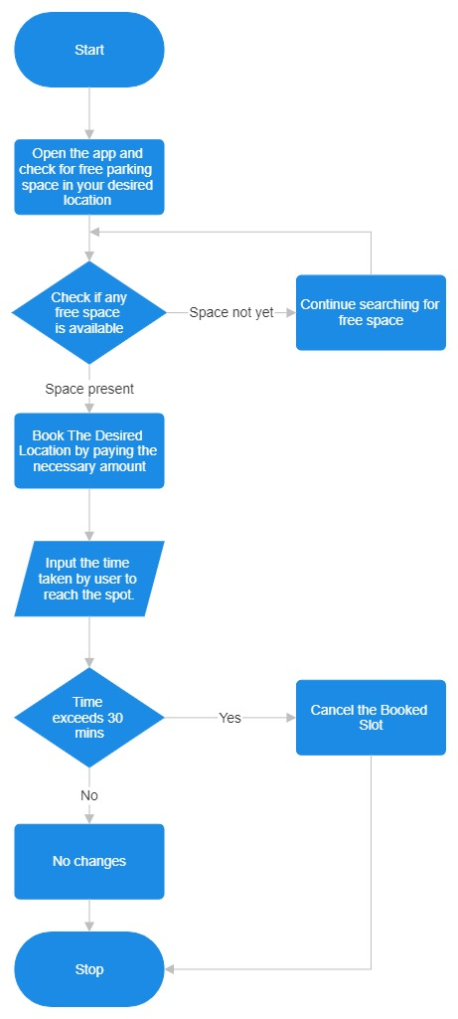
WORKING FLOW CHART

Slide 27
User Registration
Users need to register and create an account in the smart parking system's mobile app or website.
Finding Available Parking Slots
Users can check the availability of parking slots in real-time through the app or website.
The system should provide information about the location, number of available slots, and pricing.
Selecting a Parking Slot
Users can select an available parking slot based on their preferences, such as proximity to their destination or budget.
Booking a Slot
Once a user selects a parking slot, they can proceed to book it.
The system should allow users to choose the place and slot.

Slide 28
Payment
Users need to make a payment for the reserved parking slot. This can be done through various payment methods, such as credit/debit cards, mobile wallets, or prepaid parking credits
Confirmation
After a successful payment, users should receive a confirmation with details of their booking, including a QR code or booking ID.
Entry and Exit
To access the parking facility, users can scan the QR code or present the booking ID at the entry gate.
The system should track entry and exit times to calculate the parking duration.
Extensions and Cancellations
Users may have the option to extend their parking duration if needed, provided there are available slots.
Cancellation policies should be in place, allowing users to cancel their bookings with a refund if they change their plans.

Slide 29
Real-time Updates
The system should continuously update slot availability in real-time to account for cancellations or early departures.
Notifications
Users can receive notifications reminding them of their upcoming booking or when their parking time is about to expire.
Overstay Alerts
Users should be notified if they exceed their booked parking time, and additional charges may apply.
Reporting and Analytics
The smart parking system can generate reports and analytics to help parking facility managers optimize slot allocation, pricing, and overall operations.

Slide 30
Integration with Navigation
Integration with navigation apps can provide users with directions to their reserved parking spot within the facility.
Security
The system should ensure the security of user data and payment information.

Slide 31
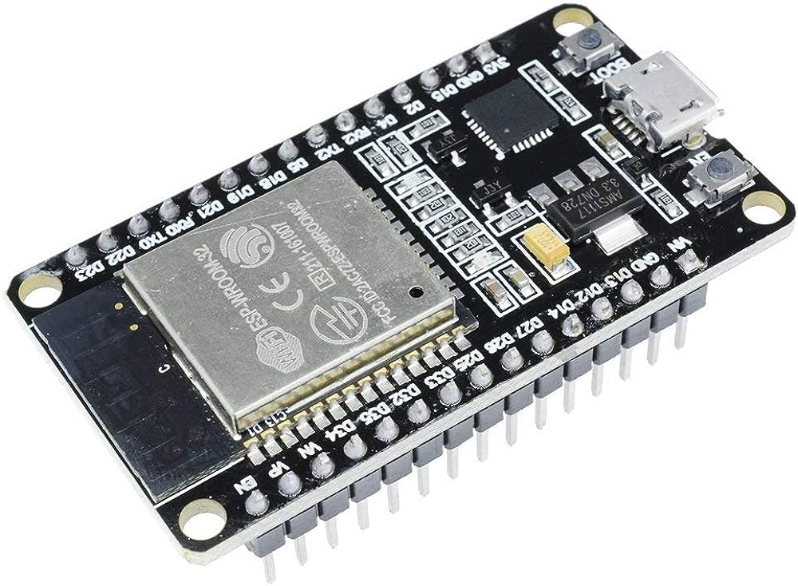
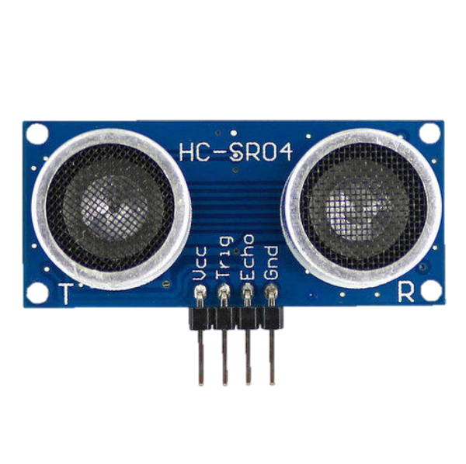
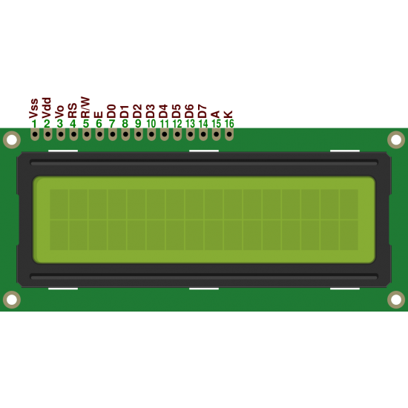
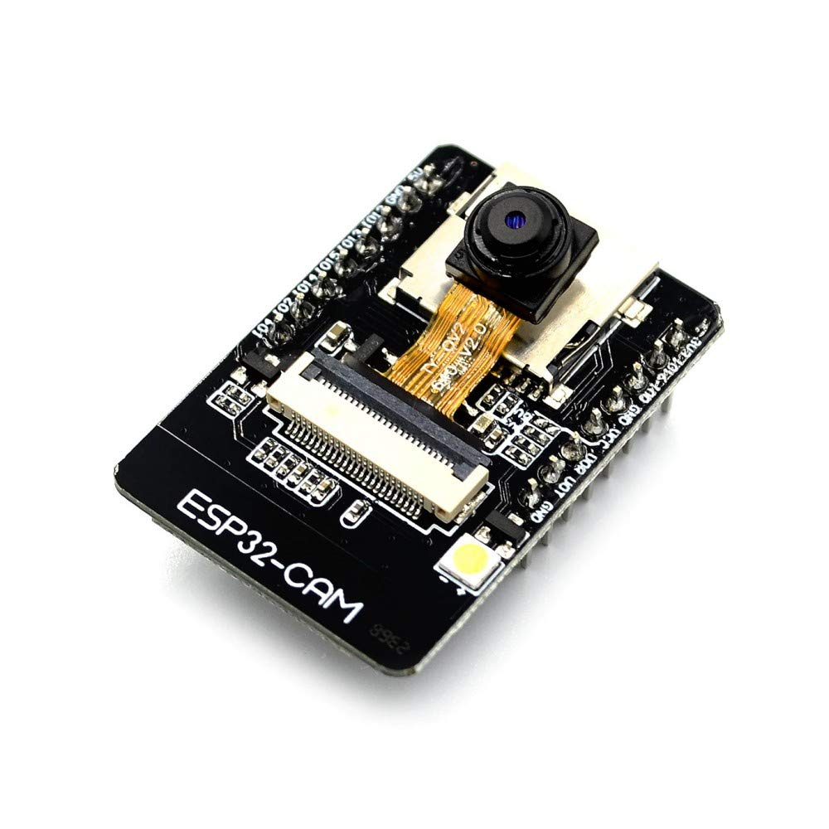
Components
ESP 32
ULTRASONIC SENSOR
16 x 2 LCD display
Camera Module

Slide 32
02
AUTOMATIC PARKING

Slide 33
INTRODUCTION
Automatic car parking, also known as automated valet parking or autonomous parking, is a technology that enables a vehicle to park itself without the need for human intervention. This technology uses a combination of sensors, cameras, computer vision, artificial intelligence (AI), and advanced control systems to navigate, manoeuvre, and park a car safely and accurately.

Slide 34
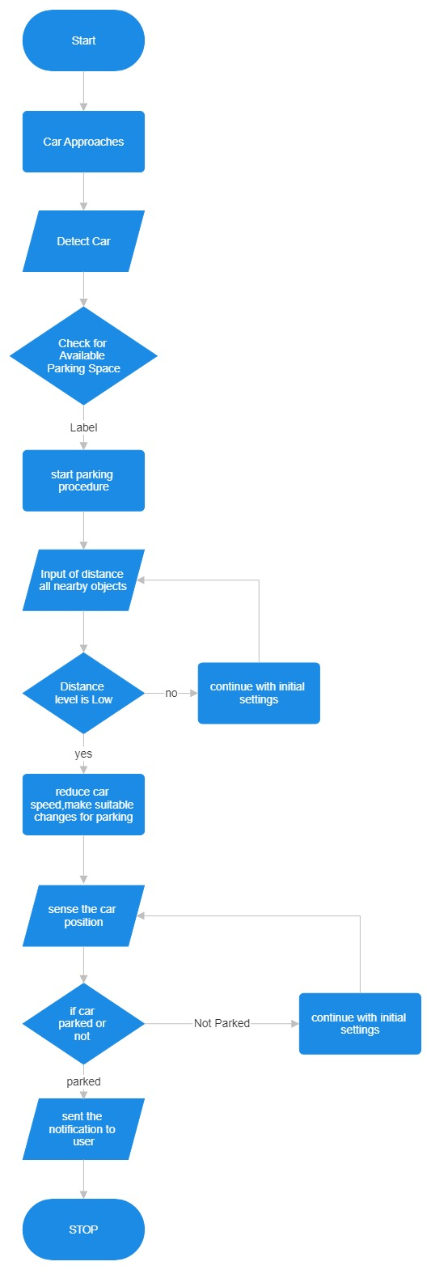
WORKING FLOW CHART

Slide 35
Vehicle Detection
When a driver arrives at a location equipped with automatic car parking, the vehicle's sensors and cameras scan the surroundings to detect obstacles, other vehicles, and available parking spaces
Mapping and Path Planning
The onboard computer system creates a map of the parking area and identifies suitable parking spaces based on the vehicle's size and the available spaces. It also plans the optimal path to the selected parking spot.
Vehicle Control
The car's autonomous driving system takes control of acceleration, steering, braking, and other necessary functions to safely navigate the vehicle to the chosen parking space. It uses real-time sensor data to make adjustments and avoid obstacles.
Parking Manoeuvres
The vehicle performs precise manoeuvres, including parallel parking, perpendicular parking, or diagonal parking, depending on the available parking space and the driver's preferences.

Slide 36
Monitoring and Safety
Throughout the parking process, the system continuously monitors the vehicle's surroundings, detecting any unexpected obstacles or changes in the environment. It can halt the parking process if necessary to ensure safety.
Parking Completion
Once the vehicle reaches the desired parking spot, it stops, aligns itself properly within the space, and engages the parking brake

Slide 37
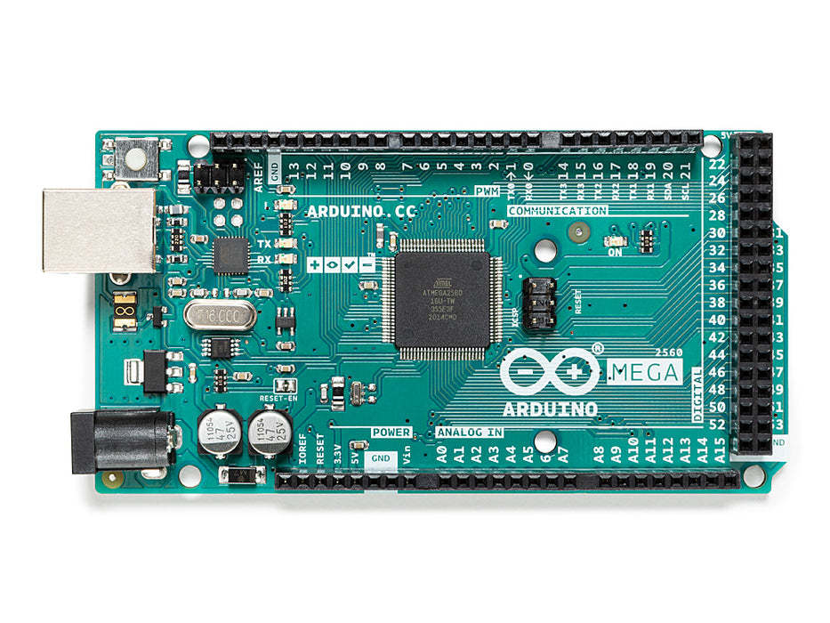
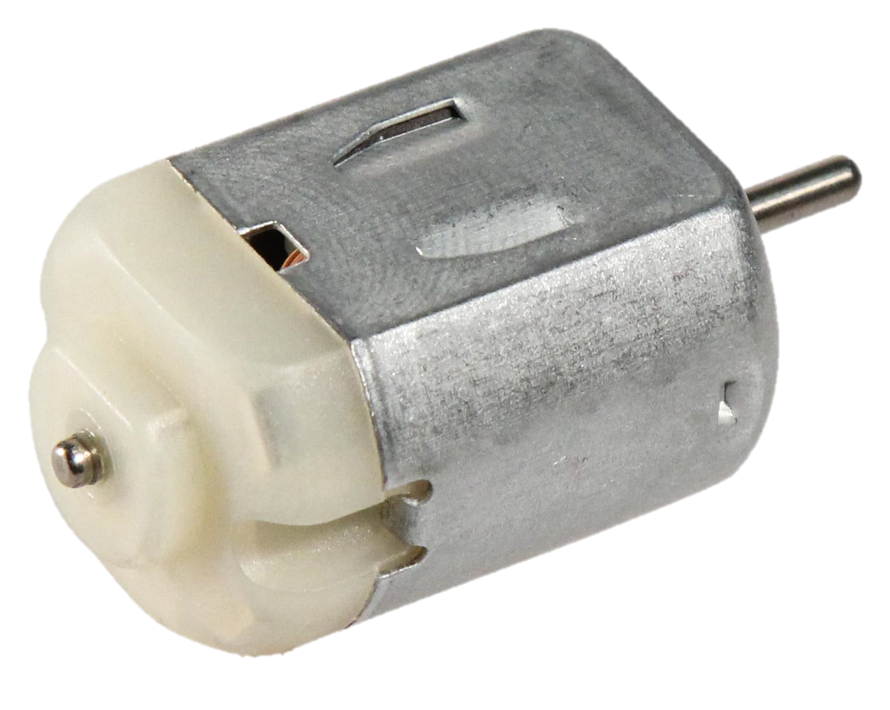
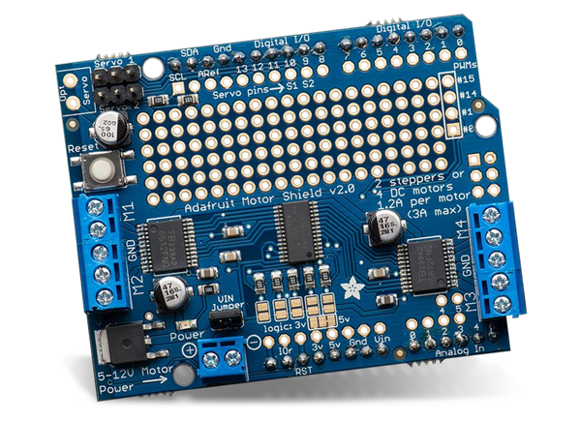
Components
Arduino Mega
ULTRASONIC SENSOR
Dc Motor
Adafruit Motor Shield

Slide 38
PHASE 3

Slide 39
Autonomous Smart Parking System (ASPS)
IBM Naan Mudhalvan-Group 2
Internet Of Things(IOT)
5113: Kingston Engineering College
By:
Naveen Moses D | au511321106017 | naveenmosesdinesh@gmail.com
Karthick V | au511321106014 | karthicksparrow201@gmail.com
T.N.Uthrakumar | autle-02ece | uthrakumar608@gmail.com
Sanjay Kumar S | au511321106020 | sanjaysivakumar0910@gmail.com

Slide 40
CONTENTS
SLOT ALLOCATION AND BOOKING
Flow chart
Components & Circuit Diagram
Coding
AUTOMATIC PARKING
Flow chart
Components & Circuit Diagram
Coding

Slide 41
01
SLOT ALLOCATION AND BOOKING

Slide 42
WORKING FLOW CHART

Slide 43
User Registration
Users need to register and create an account in the smart parking system's mobile app or website.
Finding Available Parking Slots
Users can check the availability of parking slots in real-time through the app or website.
The system should provide information about the location, number of available slots, and pricing.
Selecting a Parking Slot
Users can select an available parking slot based on their preferences, such as proximity to their destination or budget.
Booking a Slot
Once a user selects a parking slot, they can proceed to book it.
The system should allow users to choose the place and slot.

Slide 44
Payment
Users need to make a payment for the reserved parking slot. This can be done through various payment methods, such as credit/debit cards, mobile wallets, or prepaid parking credits
Confirmation
After a successful payment, users should receive a confirmation with details of their booking, including a QR code or booking ID.
Entry and Exit
To access the parking facility, users can scan the QR code or present the booking ID at the entry gate.
The system should track entry and exit times to calculate the parking duration.
Extensions and Cancellations
Users may have the option to extend their parking duration if needed, provided there are available slots.
Cancellation policies should be in place, allowing users to cancel their bookings with a refund if they change their plans.

Slide 45
Real-time Updates
The system should continuously update slot availability in real-time to account for cancellations or early departures.
Notifications
Users can receive notifications reminding them of their upcoming booking or when their parking time is about to expire.
Overstay Alerts
Users should be notified if they exceed their booked parking time, and additional charges may apply.
Reporting and Analytics
The smart parking system can generate reports and analytics to help parking facility managers optimize slot allocation, pricing, and overall operations.

Slide 46
Integration with Navigation
Integration with navigation apps can provide users with directions to their reserved parking spot within the facility.
Security
The system should ensure the security of user data and payment information.

Slide 47
Components
ESP 32
ULTRASONIC SENSOR
16 x 2 LCD display
Camera Module

Slide 48
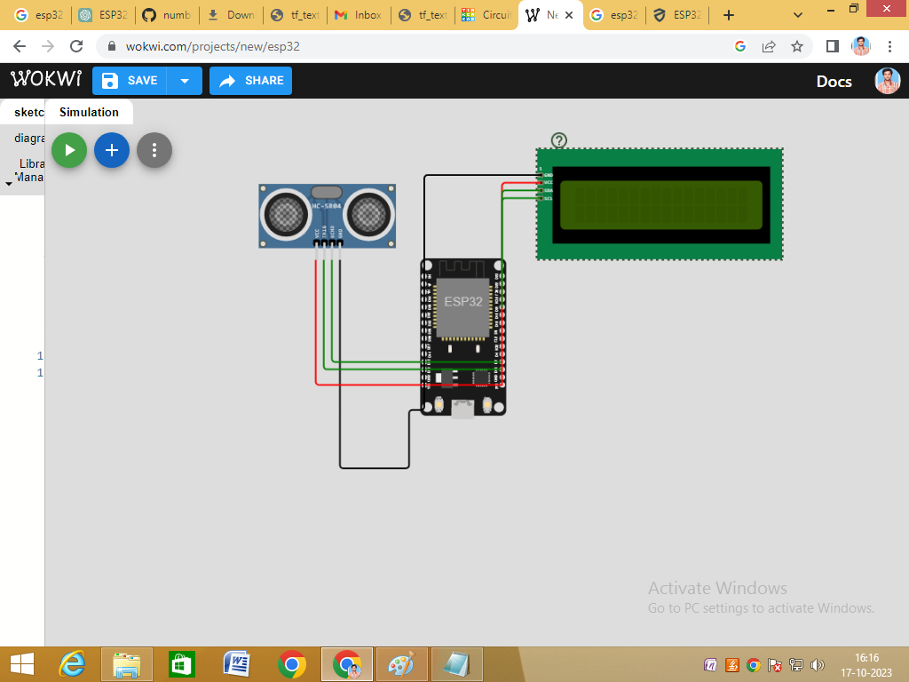
CIRCUIT DIAGRAM

Slide 49
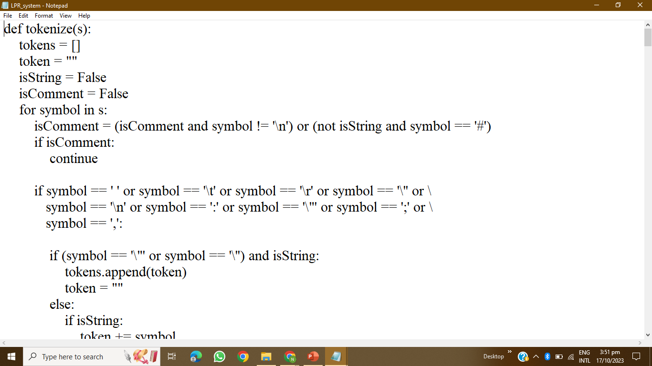
CODING

Slide 50
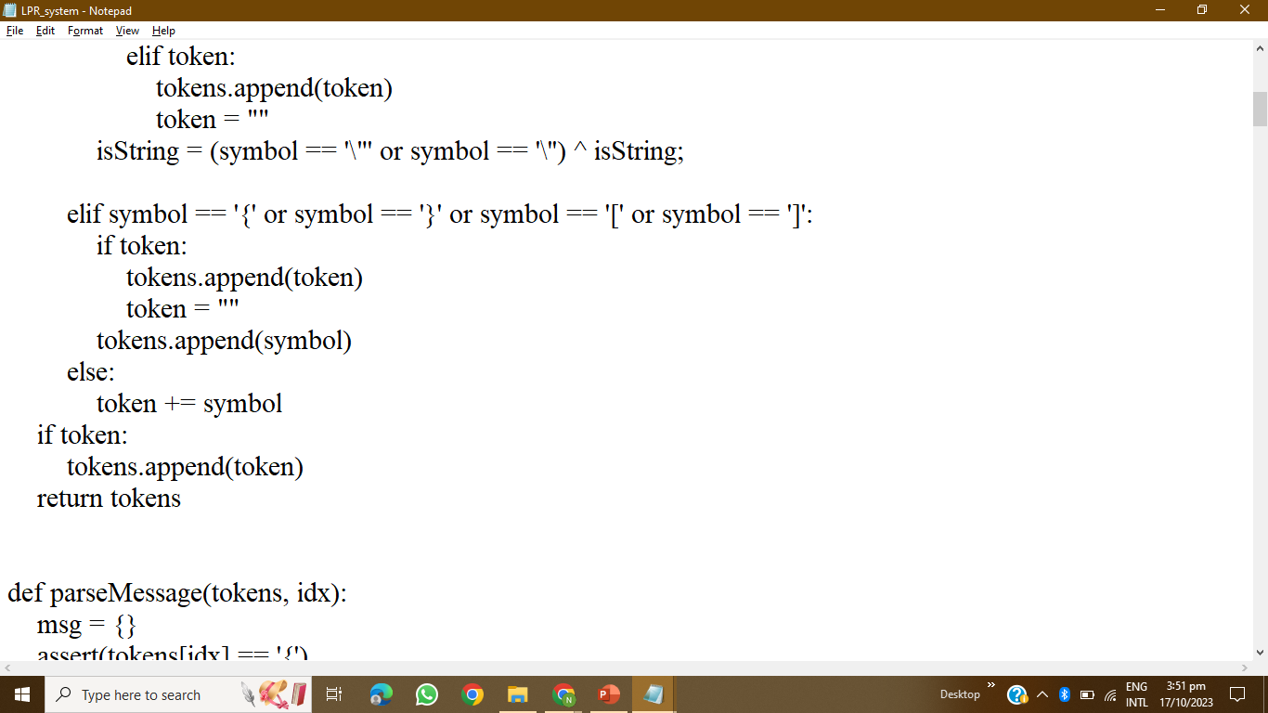
CODING

Slide 51
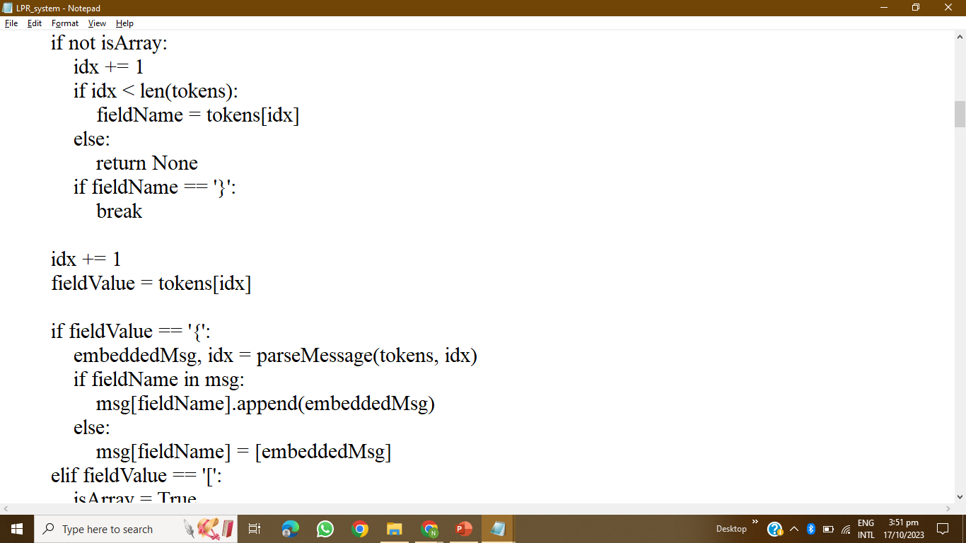
CODING

Slide 52
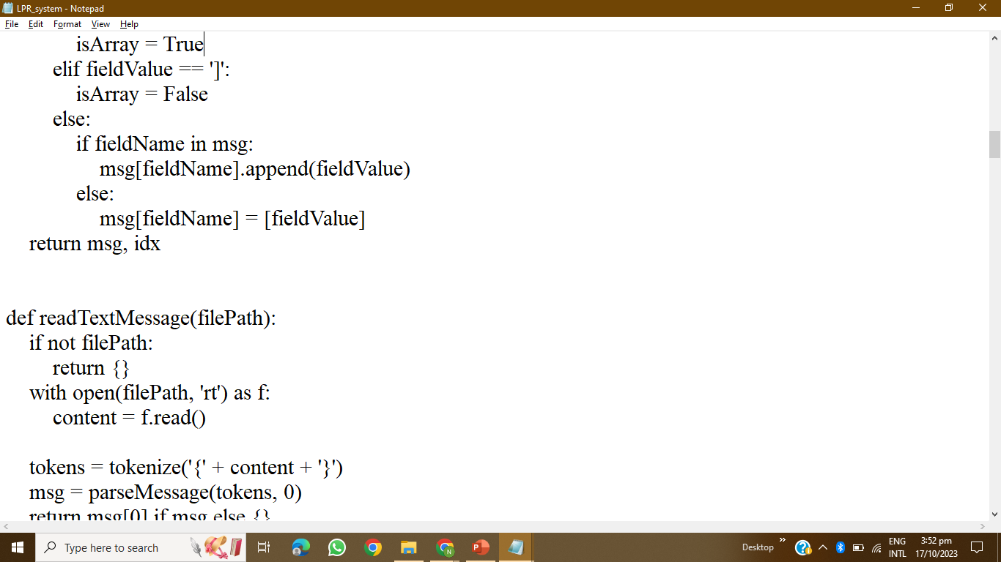
CODING

Slide 53
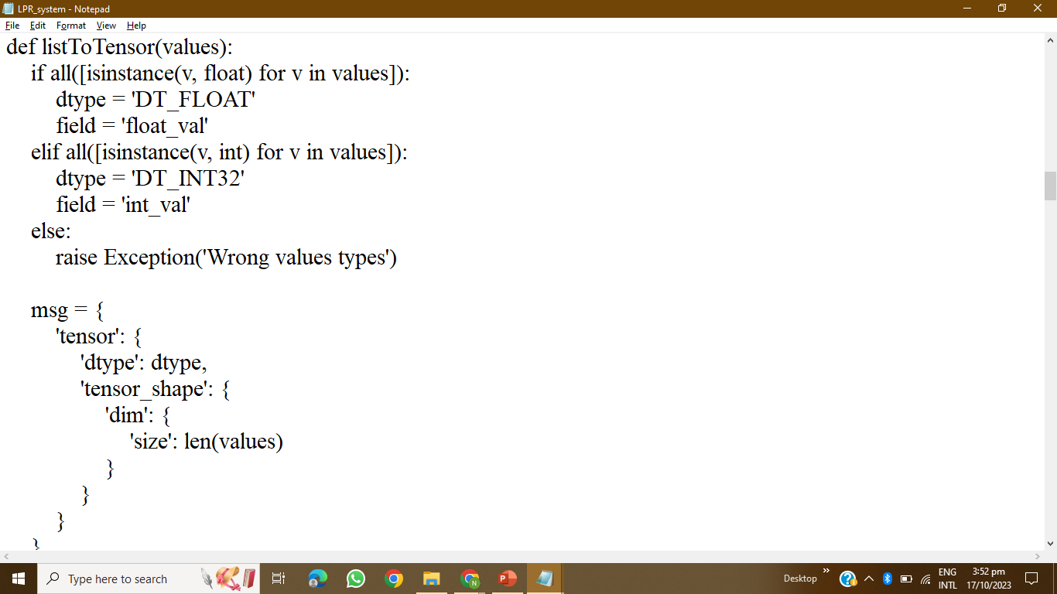
CODING

Slide 54
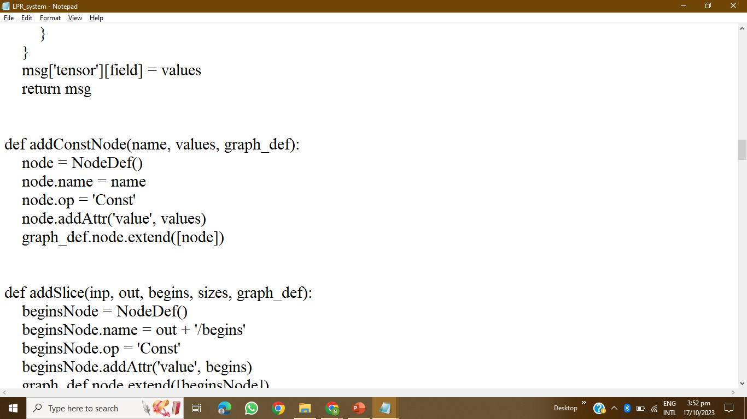
CODING

Slide 55
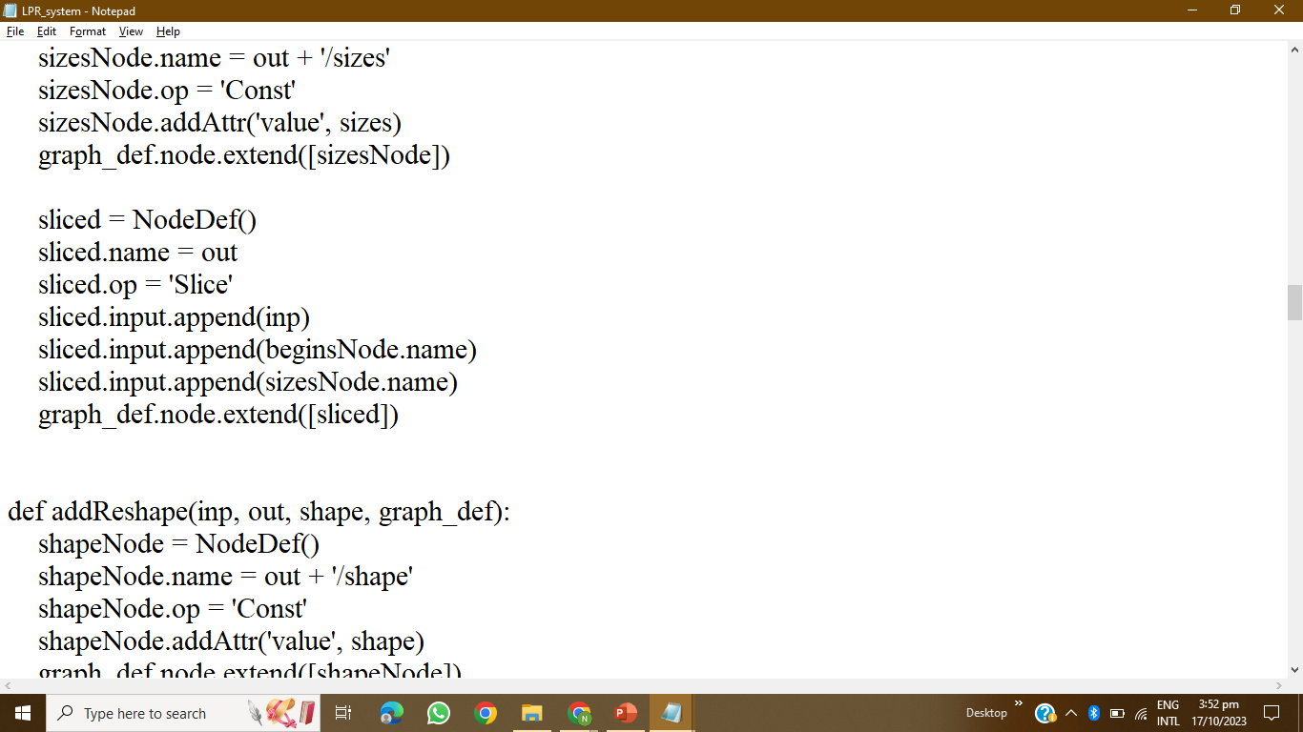
CODING

Slide 56
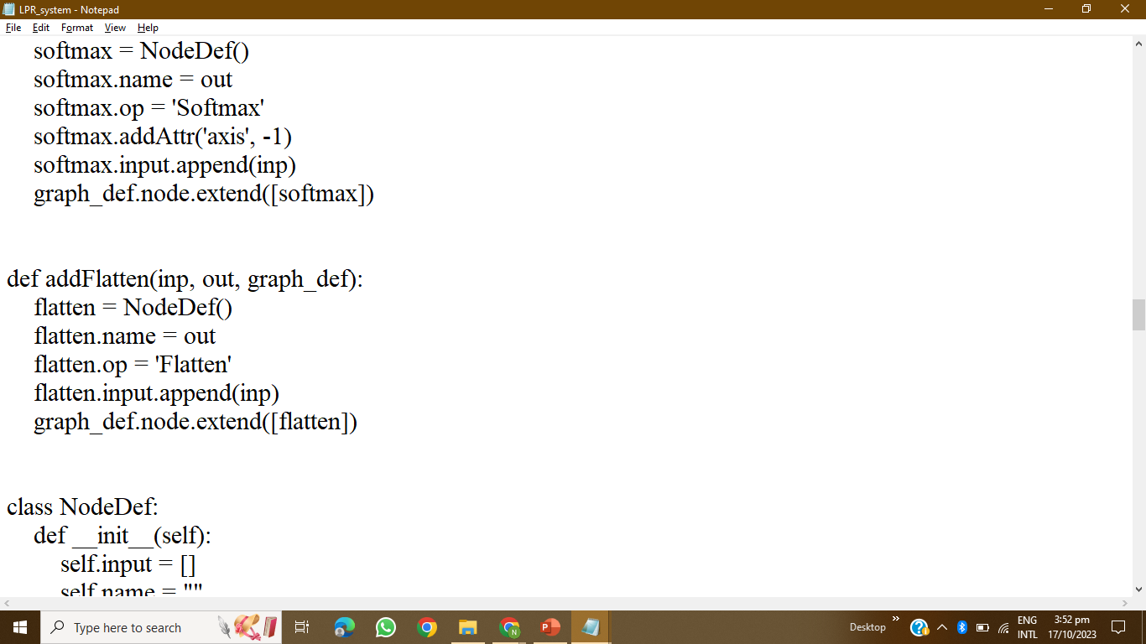
CODING

Slide 57
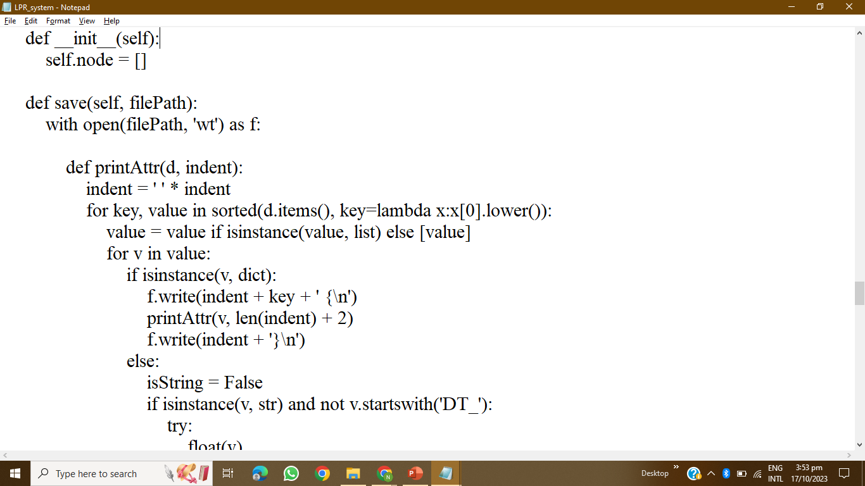
CODING

Slide 58
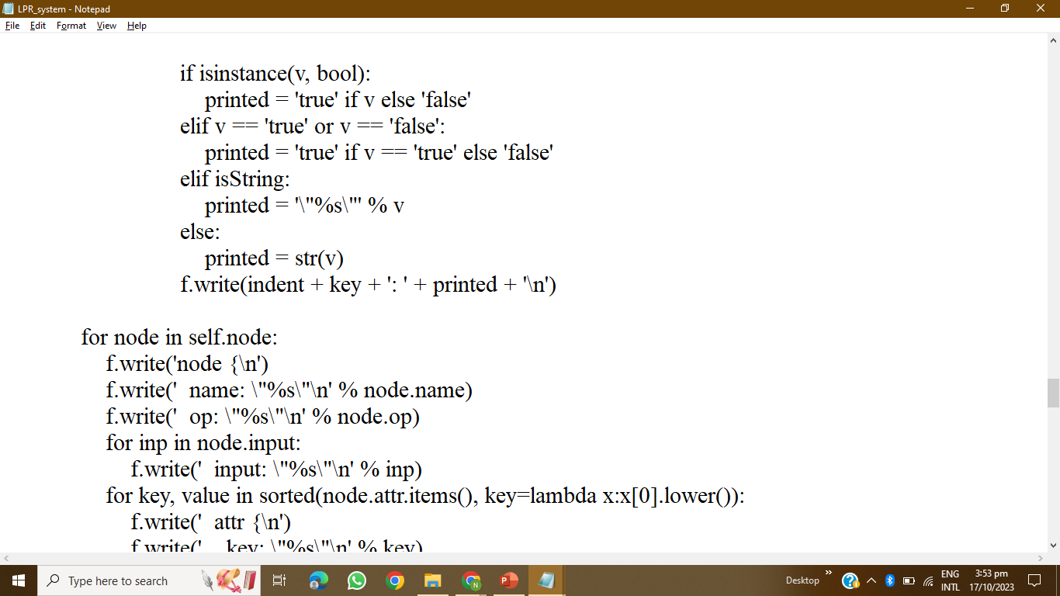
CODING

Slide 59
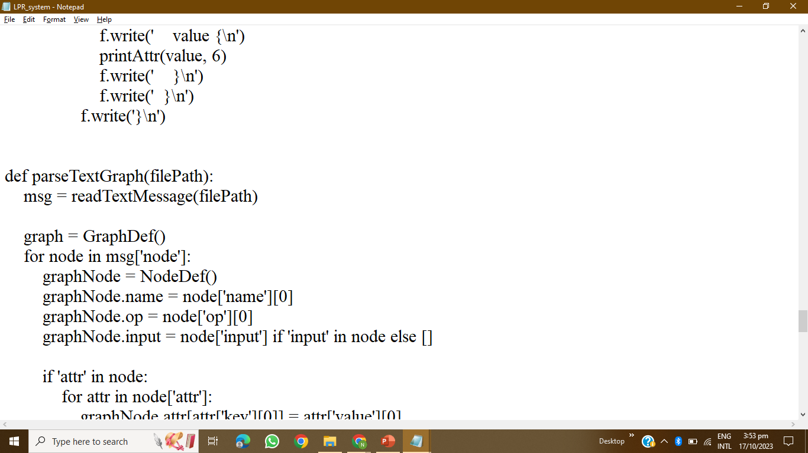
CODING

Slide 60
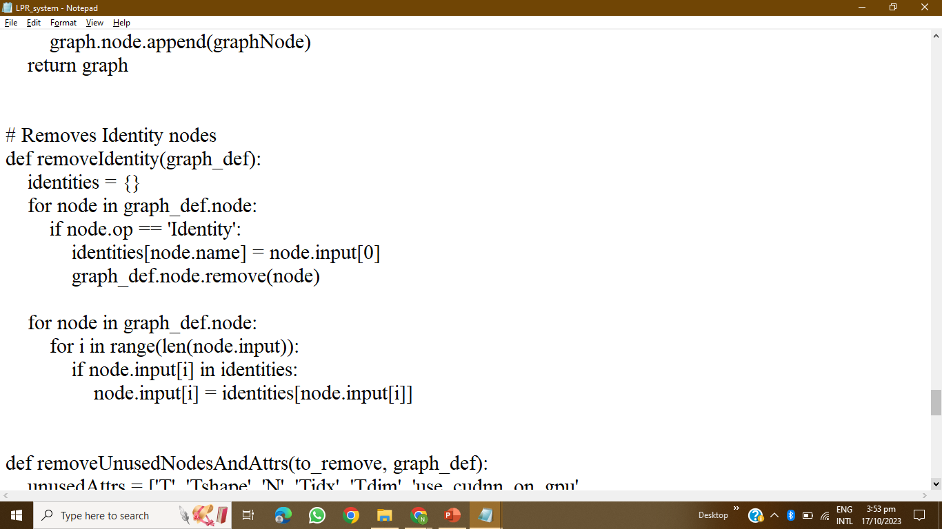
CODING

Slide 61
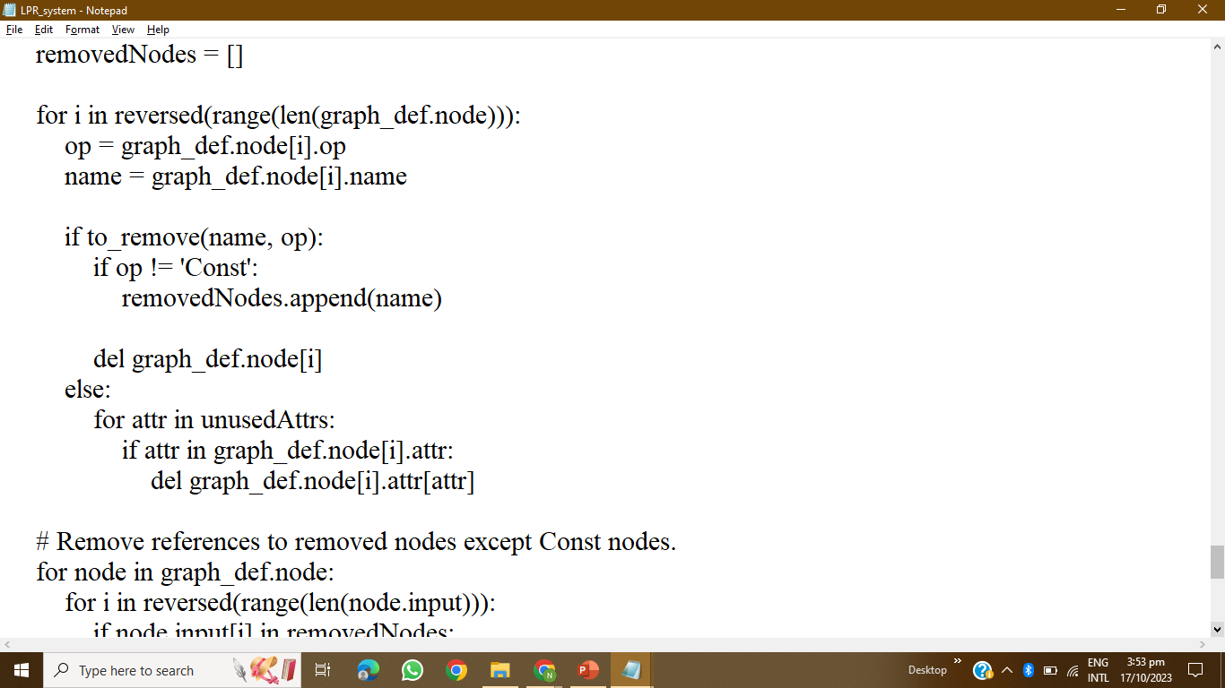
CODING

Slide 62
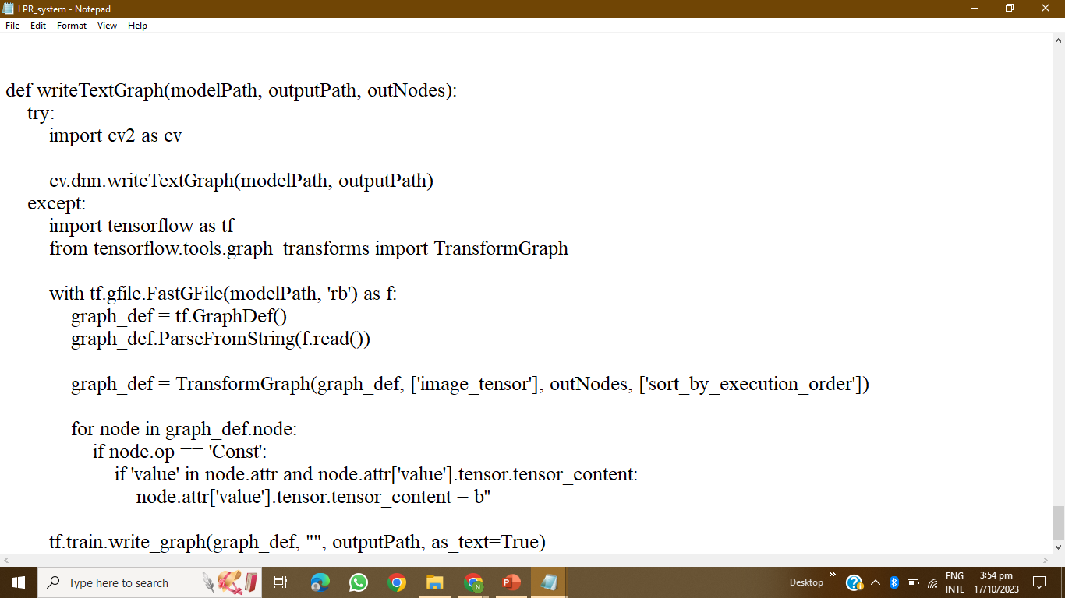
CODING

Slide 63
02
AUTOMATIC PARKING

Slide 64
WORKING FLOW CHART

Slide 65
Vehicle Detection
When a driver arrives at a location equipped with automatic car parking, the vehicle's sensors and cameras scan the surroundings to detect obstacles, other vehicles, and available parking spaces
Mapping and Path Planning
The onboard computer system creates a map of the parking area and identifies suitable parking spaces based on the vehicle's size and the available spaces. It also plans the optimal path to the selected parking spot.
Vehicle Control
The car's autonomous driving system takes control of acceleration, steering, braking, and other necessary functions to safely navigate the vehicle to the chosen parking space. It uses real-time sensor data to make adjustments and avoid obstacles.
Parking Manoeuvres
The vehicle performs precise manoeuvres, including parallel parking, perpendicular parking, or diagonal parking, depending on the available parking space and the driver's preferences.

Slide 66
Monitoring and Safety
Throughout the parking process, the system continuously monitors the vehicle's surroundings, detecting any unexpected obstacles or changes in the environment. It can halt the parking process if necessary to ensure safety.
Parking Completion
Once the vehicle reaches the desired parking spot, it stops, aligns itself properly within the space, and engages the parking brake

Slide 67
Components
Arduino Mega
ULTRASONIC SENSOR
Dc Motor
Adafruit Motor Shield

Slide 68
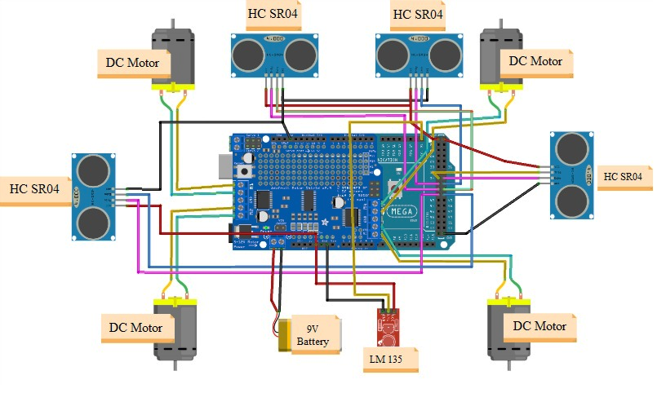
CIRCUIT DIAGRAM

Slide 69
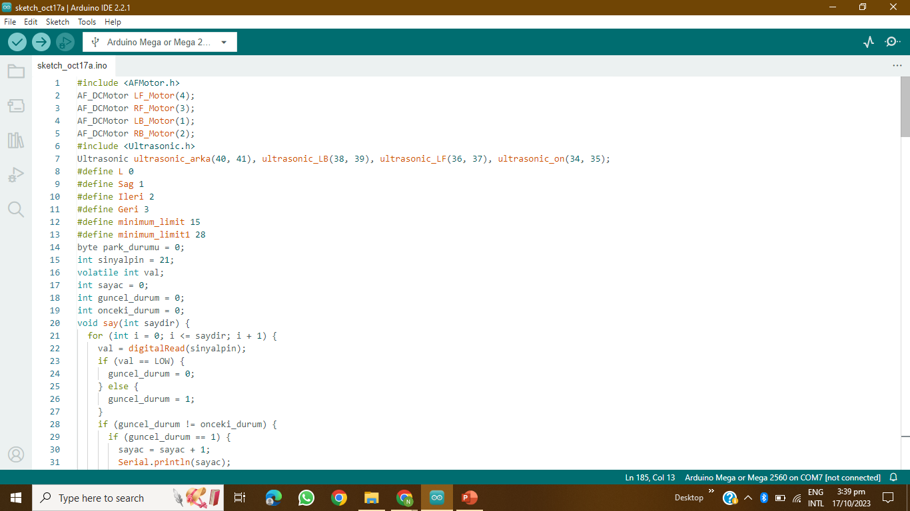
CODING

Slide 70
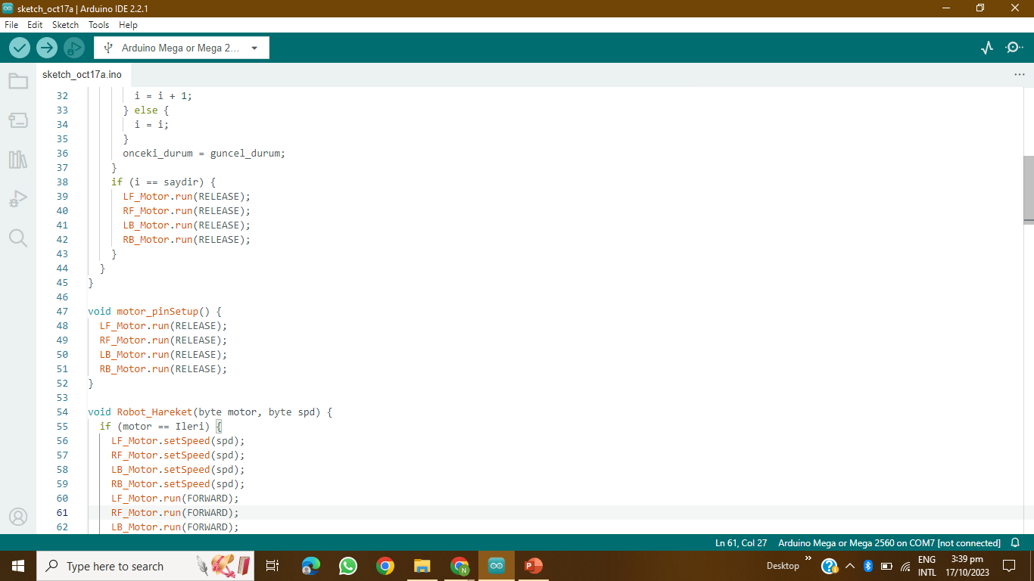
CODING

Slide 71
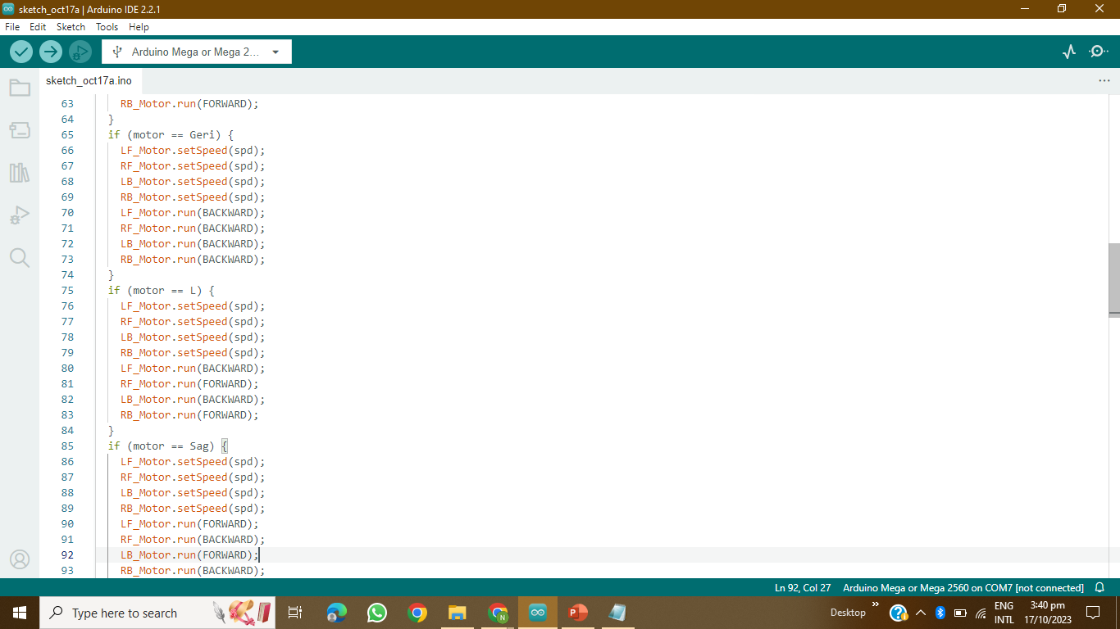
CODING

Slide 72
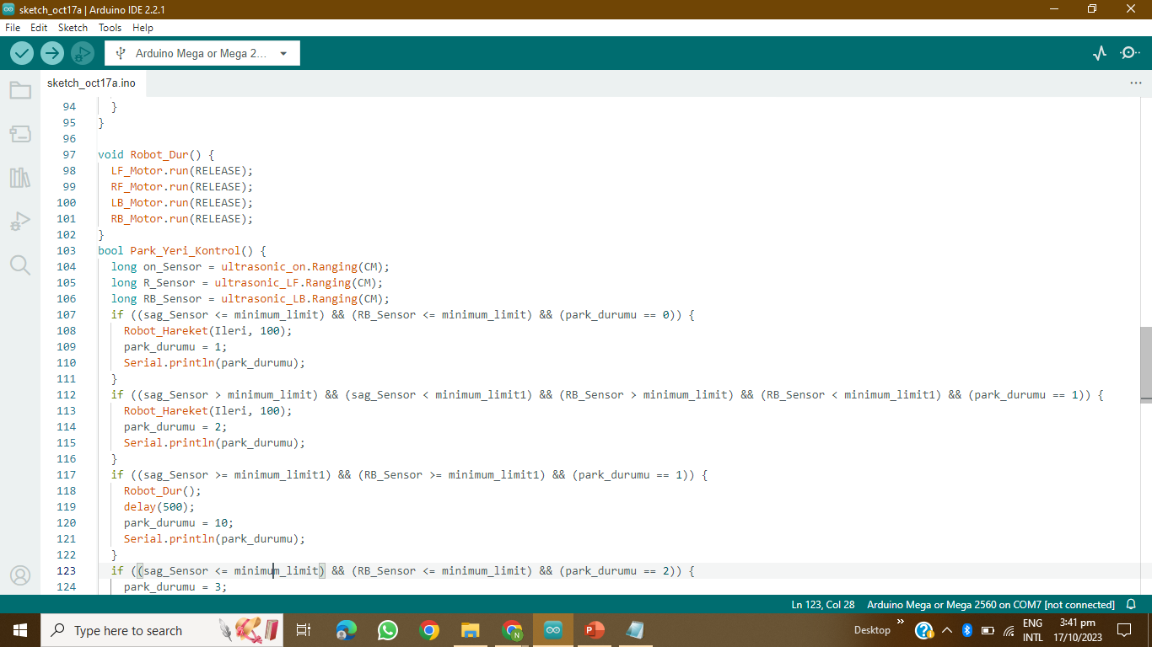
CODING

Slide 73
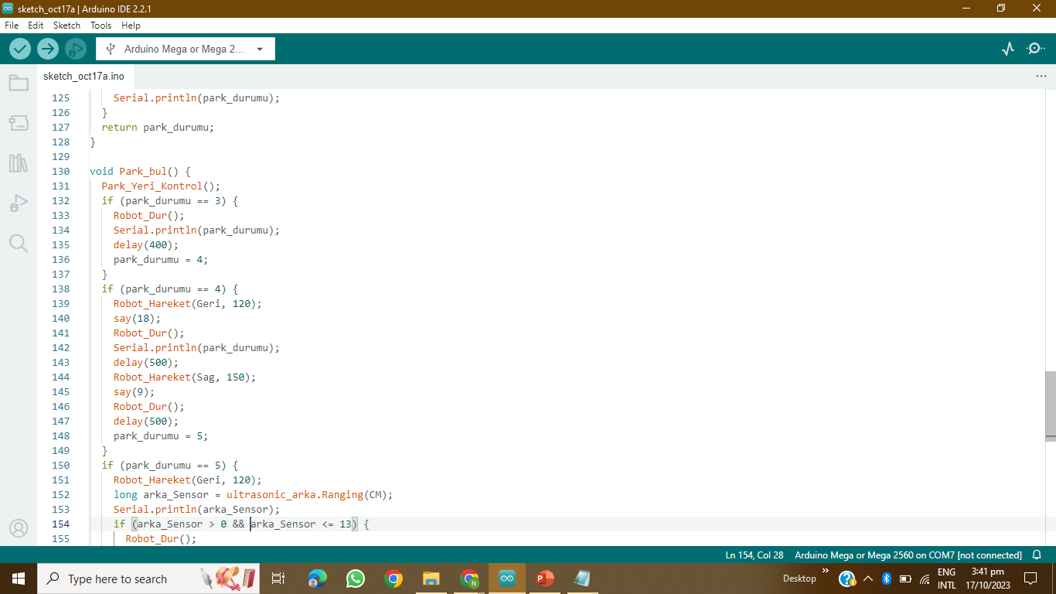
CODING

Slide 74
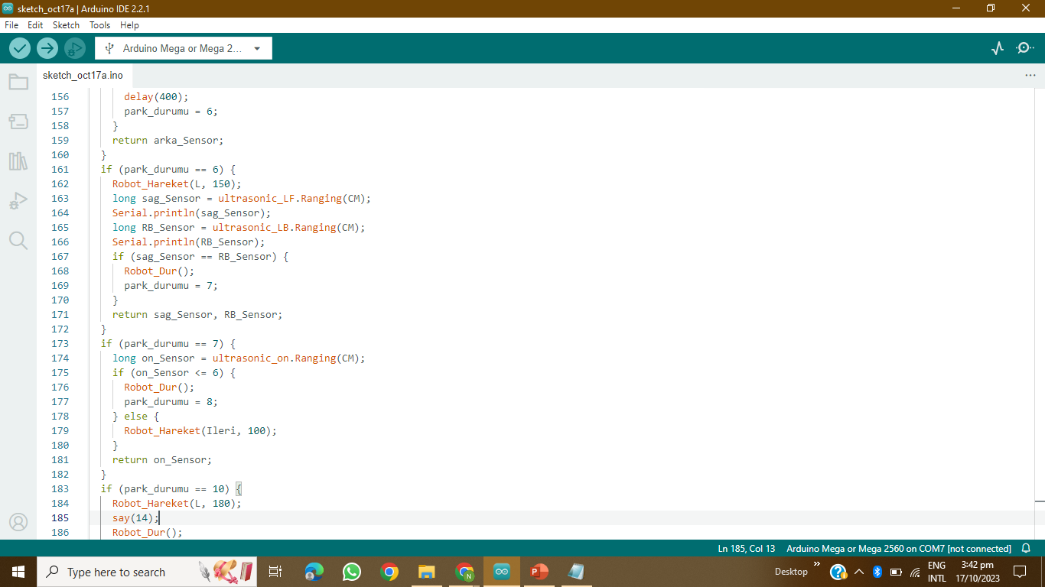
CODING

Slide 75
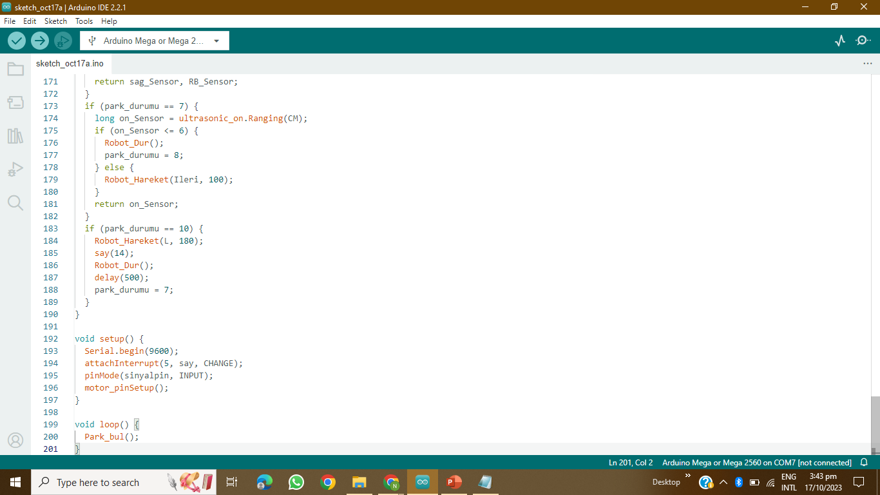
CODING

Slide 76
PHASE 4

Slide 77
Autonomous Smart Parking System (ASPS)
IBM Naan Mudhalvan-Group 2
Internet Of Things(IOT)
5113: Kingston Engineering College
By:
Naveen Moses D | au511321106017 | naveenmosesdinesh@gmail.com
Karthick V | au511321106014 | karthicksparrow201@gmail.com
T.N.Uthrakumar | autle-02ece | uthrakumar608@gmail.com
Sanjay Kumar S | au511321106020 | sanjaysivakumar0910@gmail.com

Slide 78
CONTENTS
SLOT ALLOCATION AND BOOKING
Flow chart
Components & Circuit Diagram
Coding
AUTOMATIC PARKING
Flow chart
Components & Circuit Diagram
Coding
BLINK
Introduction
Flow chart
Work Flow

Slide 79
01
SLOT ALLOCATION AND BOOKING

Slide 80
WORKING FLOW CHART

Slide 81
User Registration
Users need to register and create an account in the smart parking system's mobile app or website.
Finding Available Parking Slots
Users can check the availability of parking slots in real-time through the app or website.
The system should provide information about the location, number of available slots, and pricing.
Selecting a Parking Slot
Users can select an available parking slot based on their preferences, such as proximity to their destination or budget.
Booking a Slot
Once a user selects a parking slot, they can proceed to book it.
The system should allow users to choose the place and slot.

Slide 82
Payment
Users need to make a payment for the reserved parking slot. This can be done through various payment methods, such as credit/debit cards, mobile wallets, or prepaid parking credits
Confirmation
After a successful payment, users should receive a confirmation with details of their booking, including a QR code or booking ID.
Entry and Exit
To access the parking facility, users can scan the QR code or present the booking ID at the entry gate.
The system should track entry and exit times to calculate the parking duration.
Extensions and Cancellations
Users may have the option to extend their parking duration if needed, provided there are available slots.
Cancellation policies should be in place, allowing users to cancel their bookings with a refund if they change their plans.

Slide 83
Real-time Updates
The system should continuously update slot availability in real-time to account for cancellations or early departures.
Notifications
Users can receive notifications reminding them of their upcoming booking or when their parking time is about to expire.
Overstay Alerts
Users should be notified if they exceed their booked parking time, and additional charges may apply.
Reporting and Analytics
The smart parking system can generate reports and analytics to help parking facility managers optimize slot allocation, pricing, and overall operations.

Slide 84
Integration with Navigation
Integration with navigation apps can provide users with directions to their reserved parking spot within the facility.
Security
The system should ensure the security of user data and payment information.

Slide 85
Components
ESP 32
ULTRASONIC SENSOR
16 x 2 LCD display
Camera Module

Slide 86
CIRCUIT DIAGRAM

Slide 87
CODING

Slide 88
CODING

Slide 89
CODING

Slide 90
CODING

Slide 91
CODING

Slide 92
CODING

Slide 93
CODING

Slide 94
CODING

Slide 95
CODING

Slide 96
CODING

Slide 97
CODING

Slide 98
CODING

Slide 99
CODING

Slide 100
CODING

Slide 101
02
AUTOMATIC PARKING

Slide 102
WORKING FLOW CHART

Slide 103
Vehicle Detection
When a driver arrives at a location equipped with automatic car parking, the vehicle's sensors and cameras scan the surroundings to detect obstacles, other vehicles, and available parking spaces
Mapping and Path Planning
The onboard computer system creates a map of the parking area and identifies suitable parking spaces based on the vehicle's size and the available spaces. It also plans the optimal path to the selected parking spot.
Vehicle Control
The car's autonomous driving system takes control of acceleration, steering, braking, and other necessary functions to safely navigate the vehicle to the chosen parking space. It uses real-time sensor data to make adjustments and avoid obstacles.
Parking Manoeuvres
The vehicle performs precise manoeuvres, including parallel parking, perpendicular parking, or diagonal parking, depending on the available parking space and the driver's preferences.

Slide 104
Monitoring and Safety
Throughout the parking process, the system continuously monitors the vehicle's surroundings, detecting any unexpected obstacles or changes in the environment. It can halt the parking process if necessary to ensure safety.
Parking Completion
Once the vehicle reaches the desired parking spot, it stops, aligns itself properly within the space, and engages the parking brake

Slide 105
Components
Arduino Mega
ULTRASONIC SENSOR
Dc Motor
Adafruit Motor Shield

Slide 106
CIRCUIT DIAGRAM

Slide 107
CODING

Slide 108
CODING

Slide 109
CODING

Slide 110
CODING

Slide 111
CODING

Slide 112
CODING

Slide 113
CODING

Slide 114
03
BLYNK

Slide 115

Introduction
Blynk is a user-friendly Internet of Things (IoT) platform that simplifies the development of IoT projects for both experienced developers and hobbyists. It offers a drag-and-drop interface, enabling users to create customized mobile applications to control and monitor connected hardware without the need for extensive programming or hardware expertise. Blynk is compatible with a wide array of hardware platforms, including Arduino, Raspberry Pi, and ESP8266, allowing users to connect their devices to the Blynk cloud and develop intuitive and interactive mobile apps for device control and data visualization. The platform provides various widgets such as buttons and sliders to facilitate interaction with IoT devices. Blynk's ease of use and strong community support have made it a popular choice among IoT enthusiasts, enabling them to rapidly prototype and deploy IoT applications with minimal learning curve.

Slide 116
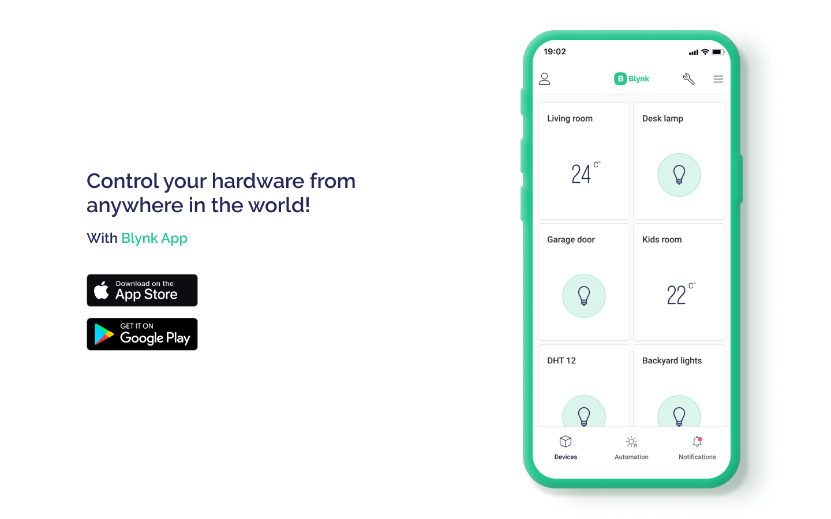
BLYNK

Slide 117
FLOW CHART
BLYNK
ESP32 Module
Arduino Mega

Slide 118
WORK FLOW
This project aims to create a Smart Parking Management System that utilizes an ESP32-CAM module to monitor and relay real-time information about available parking spaces in a designated area to a Blynk app. Additionally, the system includes an autonomous parking rover constructed using an Arduino Mega, which can receive this parking information from Blynk and navigate to an available parking space independently.

Slide 119
BUDGET
S.No | COMPONENTS | PRICE
1 | 16 x 2 LCD display | 100
2 | Camera Module | 480
3 | ESP 32 Module | 400
4 | ULTRASONIC SENSOR | 250
5 | Arduino Mega | 4,300.00
6 | Adafruit Motor Shield | 1700
7 | Dc Motor | 1080
8 | LM135 | 690
TOTAL | TOTAL | 9000

Slide 120
ADVANTAGE
Reduce Parking Stress
Cost and Time Efficient Solution
Minimize the Personal Carbon Footprint
Reduce Search Traffic on Streets
Monitoring the parking space in real-time
Increased efficiency
Improved customer experience
Enhanced security
Reduced costs

Slide 121
DISADVANTAGE
Power fluctuation might affect the accuaracy of the sensors
Not accurate for parking
Chances of System breakdown
People unfamilar with latested technology will find it hard to use

Slide 122
APPLICATION
Helps in booking the parking slot well in advance
Auto parking helps people who can't parallel park
Monitoring the parking space in real-time
Minimize the Personal Carbon Footprint

Slide 123
FUTURE WORKS
In Future we have planned to add charging port for E-cars. Cameras will also be included for auto parking to develop high precision parking.

Slide 124
CONCLUSION
The project has been successfully created and simulated using online Arduino Simulators like Tinkercad, and WOKWI and the budget for the prototype has been submitted. We hope that the idea we have shared would help the people.

Slide 125


